Slide 1
Isocyanide Multicomponent Reactions in Drug Discovery
Kenneth Switala
Saginaw Valley State University

Slide 2
Outline
Process of drug discovery, pre 1995
A new strategy considered, after 1995
Multicomponent reaction basics
Research utilizing IMCRs
Directions for new MCRs

Slide 3
Drug Discovery, pre 1995
Important fields
  Natural products chemistry
  Synthetic organic chemistry
Methods
  Extraction, isolation, characterization, target validation using natural sources
  Labor intensive multi-step synthesis of drug compounds

Slide 4
Drug Discovery, post 1995
New technology and methods
  High-throughput screening
  Large chemical libraries for brute force search
  'In silico' screening
  Analysis of target on molecular level
New field
  Non-peptide Combinatorial chemistry

Slide 5
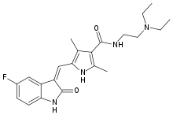
Drug Discovery, post 1995
Natural product-based drugs still dominant
  57.7% of all FDA-approved drugs as of ~Jan 2008
Random HTS on large libraries not enough
  Sunitnib

Slide 6
Libraries are still essential
Focused libraries
  Important for fine tuning of ADME/Toxicity requirements
Diversity oriented synthesis of promising lead compounds
  A logical result of needing more complicated molecules to be generated for libraries

Slide 7
Multicomponent Reactions
Defined as single step reactions that involve more than two reactants where the product incorporates most of the starting atoms
Received more attention when modern technology made screening many compounds feasible
  Each reactant is a ‘dimension’ to be varied over in a combinatorial search
  10 x 10 x 10 x 10 >> 10 x 10

Slide 8
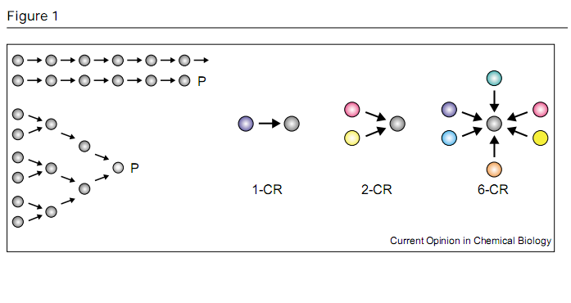
Multicomponent Reactions

Slide 9
Multicomponent reactions
Three types
  Type I – Mannich, Strecker
  Type II – Biginelli, Hantzch, Ugi, Passerini
  Type III - ???
Type II are the most useful for the generation of chemical libraries

Slide 10
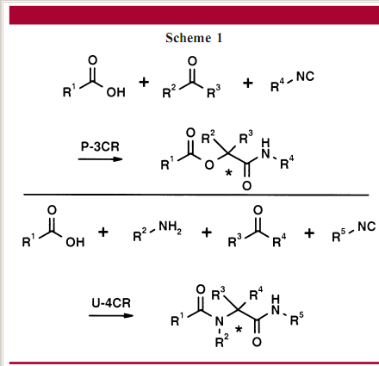
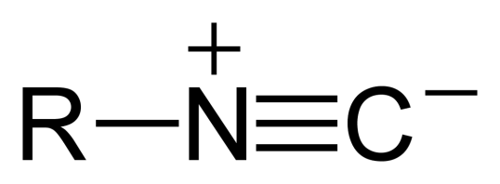
IMCRs
The isocyanide multicomponent reactions are the Ugi (4-CR) and Passerini (3-CR)

Slide 11
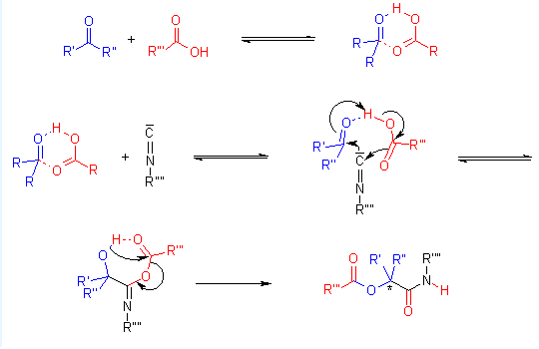
Mechanism
P-3CR

Slide 12
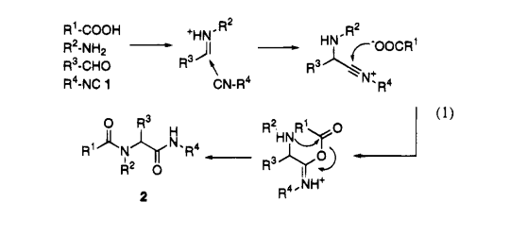
Mechanism
Ugi mechanism

Slide 13
IMCR advantages
Side reactions easily controlled
Orthogonal functional groups
  Post reaction modifications
Oxo-components and carboxylic acids are commercially available
Bond forming efficiency
Atom economy

Slide 14
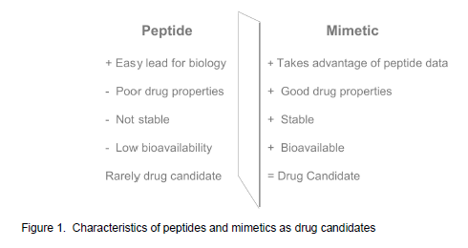
IMCR concerns
Isocyanide availibility, toxicity, odor
Peptide mimetics, according to Provid

Slide 15
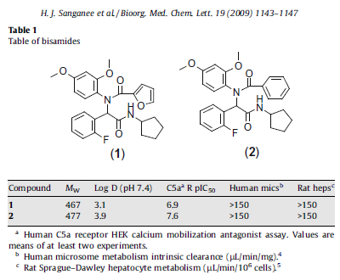
IMCRs for focused libraries
Astrazeneca library

Slide 16
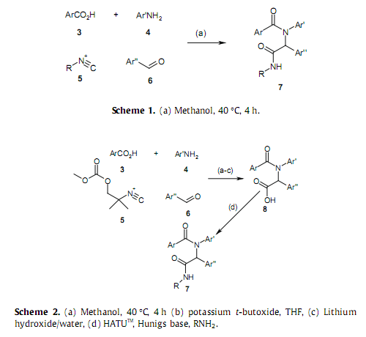
IMCRs for focused libraries

Slide 17
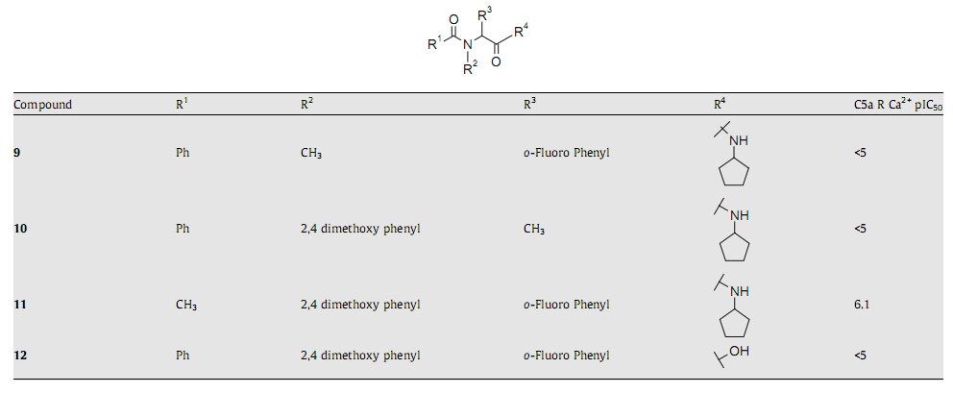
IMCRs for focused libraries
Systematic removal of single phenyl groups

Slide 18
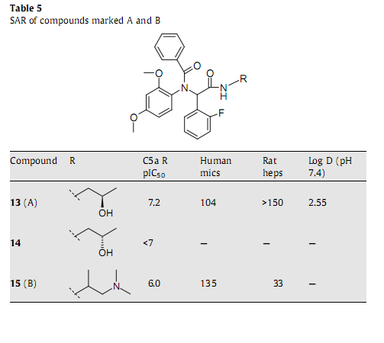
IMCRs for focused libraries

Slide 19
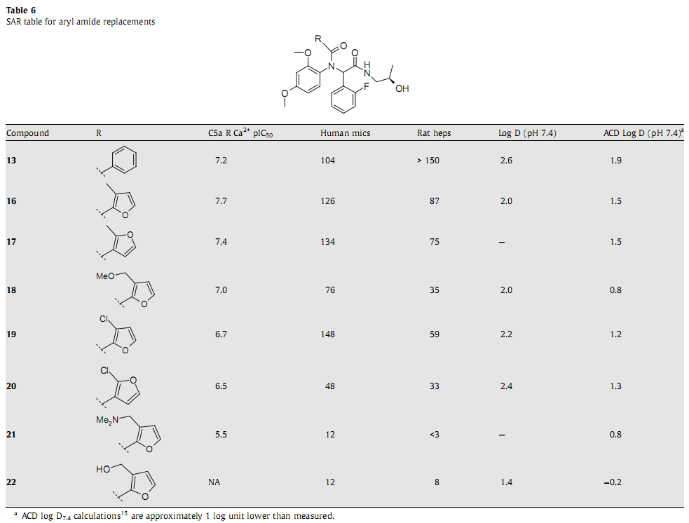
IMCRs for focused libraries

Slide 20
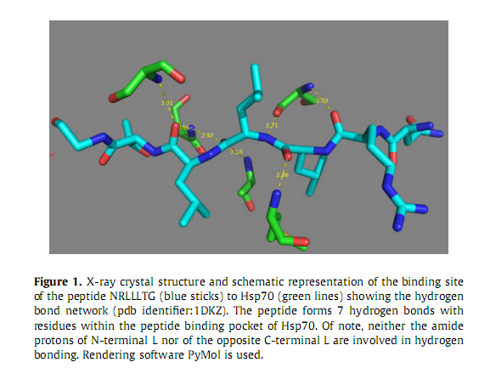
IMCRs for peptide mimetics

Slide 21
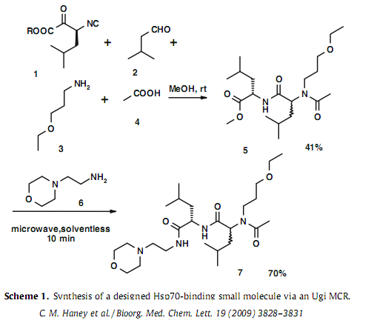
IMCRs for peptide mimetics
Resembles LLLT motif

Slide 22
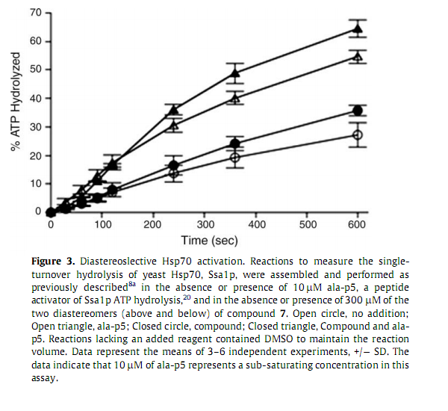
IMCRs for peptide mimetics

Slide 23
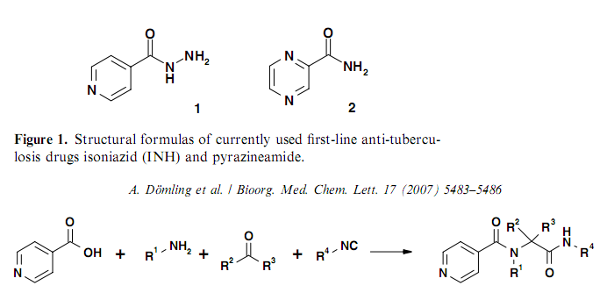
Rational design using IMCRs
Variations on a small drug molecule

Slide 24
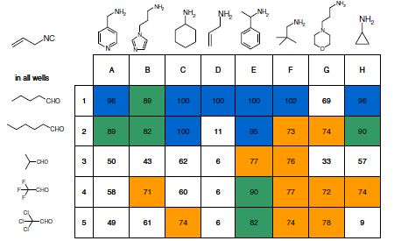
Rational design using MCRs
96 compounds were generated and tested for inhibition of H37Rv

Slide 25
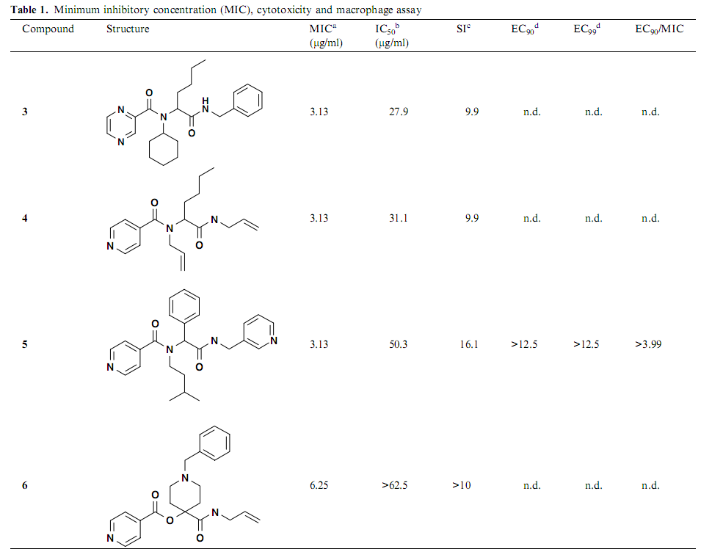
Rational design using IMCRs

Slide 26
Summary
Preliminary research from J. Bioorganic Medical Chemistry Letters
Examples of hit to lead (HtL) process

Slide 27
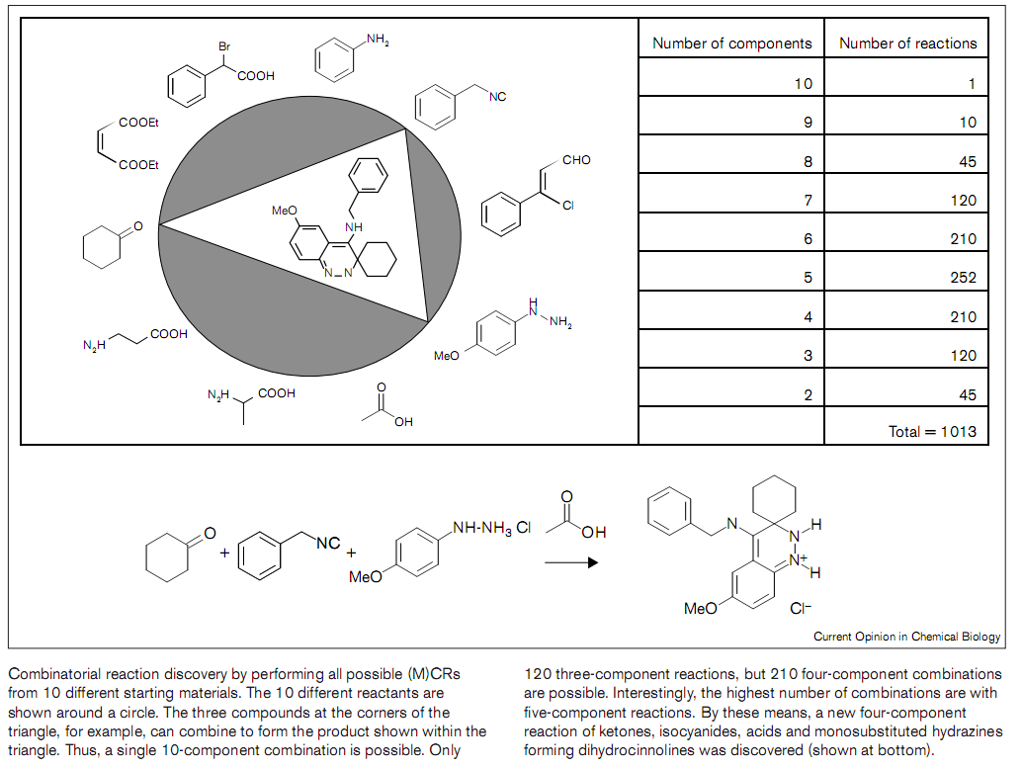
New MCRs

Slide 28
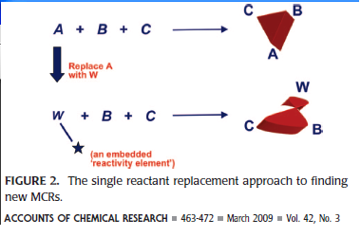
New MCRs
The U-4CR and P-3CR is (sort of) an example of this.

Slide 29
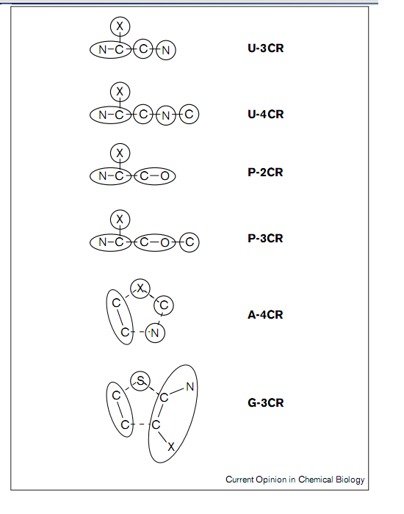
New MCRs

Slide 30
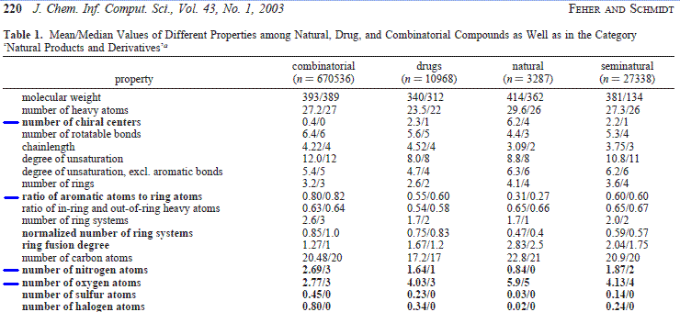
Directions for new MCRs

